Slide 1
Video Presentation:
https://youtu.be/Kv3c0GOOvPg

Slide 2
Concrete Architecture of Bitcoin Core
Group 44
Presenters: Selena Kesidis and Osamu Adun
Group Leader: Victor Coombes
Rest of Group: Kyle Verma, Anton Gudonis, Navin Pandey

Slide 3
Overview
Introduction
Derivation Process
Concrete Architecture Diagram
Components
Interactions
Alternate Architectures Considered
Conceptual + Concrete Architecture of the Wallet
Use Case and Sequence Diagram
Concurrency
Reflexion Analysis
Limitations
Team Issues
Lessons Learned
Conclusion
References

Slide 4
Introduction
Through this report, we aimed to analyze the concrete architecture of Bitcoin Core. By comparing our findings with the conceptual architecture we investigated in the last report, we will thoroughly examine the internal structure of the Bitcoin Core system. The connections and dependencies of the components, as well as the differences between the conceptual and concrete views, combine to demonstrate the intricacies of Bitcoin Core.

Slide 5
Derivation Process
To derive the concrete architecture, we analyzed the source code and compared what we found with the conceptual architecture. We used the software provided to us through the course to discover the dependencies and differences present in the concrete architecture. We found the individual files that are responsible for the discrepancies within the two architectures. This allowed us to fully analyze the concrete architecture.

Slide 6
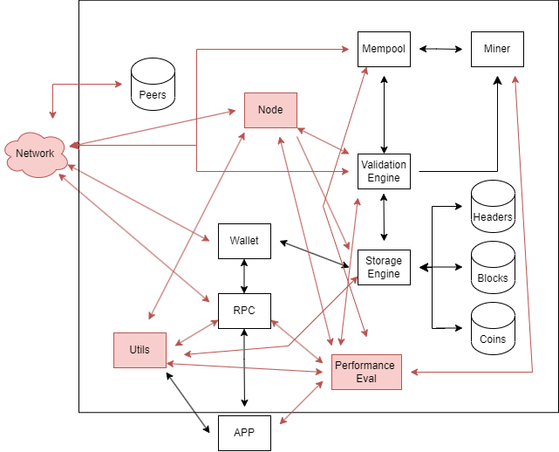
Concrete Architecture Diagram

Slide 7
Components
The new components we added to the concrete architecture, distinct from the conceptual architecture, are as follows:
Network: The Network is a component that serves the combinatorial functions of the Peer to Peer Network, Connection Manager, and P2P Discovery. Those three become subsystems of the Network, which replaces them in the concrete architecture.
Utils: The Utils component provides different utilities to various other systems, it compresses, decompresses, encrypts, and decrypts data
Performance Evaluation: The Performance Evaluation collects information on system performance and analyzes them to optimize the system

Slide 8
Interactions
The new interactions we found within the concrete architecture, distinct from the conceptual architecture, are as follows:
Util -> Storage Engine: Utils is responsible for both encrypting and decrypting data retrieved from the Storage Engine.
Util -> RPC: Utils needs access to the RPC so it can communicate with the servers to access user data that it can perform its utility functions on.
Util -> App: The App contains various types of data that the Util can perform actions on, from compressing data for easier storage later to encrypting sensitive data.
Performance Evaluation -> App/RPC/Util/Mempool/Miner/Validation Engine: The Performance Evaluation needs to interact will all of the listed systems as it retrieves performance data with the goal of optimizing their respective functions from faster and more efficient processing of blockchain transactions to faster block creations and efficient use of computing power.

Slide 9
Alternate Architectures Considered
Another option we considered when creating our concrete architecture was the client server style. This style makes sense for certain aspects of the architecture as there is a common server being accessed by the components. We also considered pub-sub style, and we chose to incorporate this into our chosen architecture of peer to peer. This architecture is complex, and so there is some mixing of styles within the design.

Slide 10
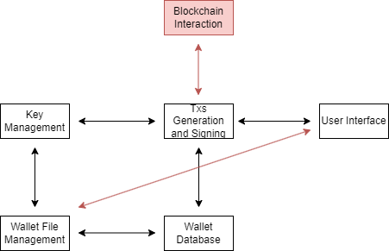
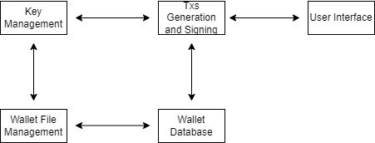
Conceptual + Concrete Architecture of the Wallet
The conceptual architecture:
The concrete architecture:

Slide 11
Conceptual + Concrete Architecture of the Wallet Analysis
We chose to analyze the wallet as our 2nd level subsystem. Through the creation and comparison of the two architectures we discovered some interesting discrepancies. The User Interface needed access to the Wallet Database so it could display that data to the user, and the dependency between the Wallet File Management and Txs Generation and Signing was unnecessary as that data was accessible from the Wallet Database along with data native to the database.

Slide 12
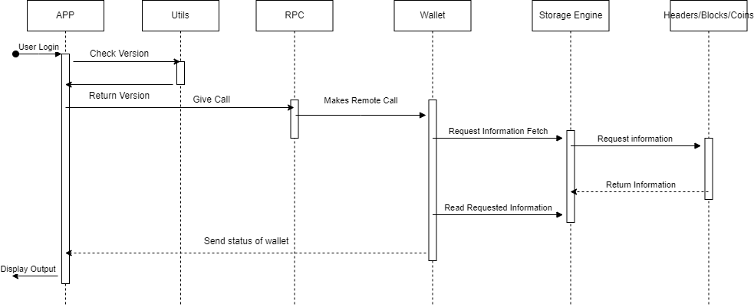
Use Case and Sequence Diagram
Our selected use case is “A user wants to log in and access their wallet and view the information inside.” In this use case, we can see the control being passed between different components within the concrete architecture.

Slide 13
Concurrency
There is some concurrency present within the Bitcoin Core architecture. Concurrency is important to the function of the system as it allows multiple components to be working together at once to produce an outcome for the user. One example of this can be seen within the Wallet subsystem as the databases simultaneously validate each transaction.

Slide 14
Reflexion Analysis
For the high-level architecture, our analysis of the concrete and conceptual architectures have allowed us to reveal some interesting aspects of the system. Within the concrete architecture, the Network system became more generalized and adopted the responsibilities of the Peer to Peer Network, P2P Discovery, and Connection Manager in the conceptual architecture. Additionally, the concrete architecture includes the Utils and Performance Evaluation components, which are not present in the conceptual architecture.

Slide 15
Limitations
The limitations of our findings are mostly due to the immense amount of source code within the Bitcoin Core system. We likely were not able to locate and identify every single dependency that is present in the architecture. Additionally, our architectural style may not perfectly describe the way that every component pair interacts. This is due to the fact that software architectures are incredibly complicated and we aim to summarize them the best way we can.

Slide 16
Team Issues
Our team had little to no serious issues working together over the course of this project. The main struggles we faced were due to communication. Collaborating and keeping in touch can be difficult with everyone’s individual schedules and workloads. Additionally, our team could have organized the project schedule better in order to ensure a smoother project creation.

Slide 17
Lessons Learned
Throughout the course of this project, our group has learned just how much thought and development goes into software architecture, both conceptual and concrete designs. The different components and how they combine tell us so much about the developers’ goals for the system. Diving deep into software architectures is the best way to completely and wholly understand the structure of a system.

Slide 18
Conclusion
To conclude, we have compared and contrasted the conceptual and concrete architectures of Bitcoin Core and discovered key dependencies that help us understand the software architecture as a whole. The new roles adopted by the Network component in the concrete architecture show us that it is a crucial aspect of the software. Additionally, the new dependencies discovered through the new components help us conceptualize the Bitcoin Core system even better than before. Overall, we have further analyzed and understood the Bitcoin Core software architecture.

Slide 19
References
https://youtu.be/Kv3c0GOOvPg
https://bitcoin.org/en/bitcoin-core/
https://wallets.com/bitcoin-core-review/
https://dl.gi.de/bitstream/handle/20.500.12116/16570/DFN-Forum-Proceedings-001.pdf?sequence=1&isAllowed=y https://dl.gi.de/bitstream/handle/20.500.12116/16570/DFN-Forum-Proceedings-001.pdf?sequence=1&isAllowed=y

